Slide 1
DESIGN A SERVER WEB FOR IOT-BASED AQUARIUM TANK USING SHINY FRAME WORK
Doan Vu Thinh^{*a}, Nguyen Minh Hoang^{a,b}
ªFaculty of Information Technology, 02 Nguyen Dinh Chieu, Khanh Hoa, Viet Nam
^{b}Student, Faculty of Information Technology, 02 Nguyen Dinh Chieu, Khanh Hoa, Viet Nam
*Corresponding author: Email: thinhdv@ntu.edu.vn | Tel: 0914949195

Slide 2
INTRODUCTION
IoT can be understood simply that all devices are connected to each other through the Internet.
IoT has evolved due to the convergence of multiple technologies:
real-time analytics,
machine learning,
commodity sensors,
and embedded systems.
There are numerous IoT applications in aquaculture such as collecting/updating data of water quality including
temperature,
dissolved oxygen,
ammonia, nitrites,
pH,
salt,
and carbonates

Slide 3
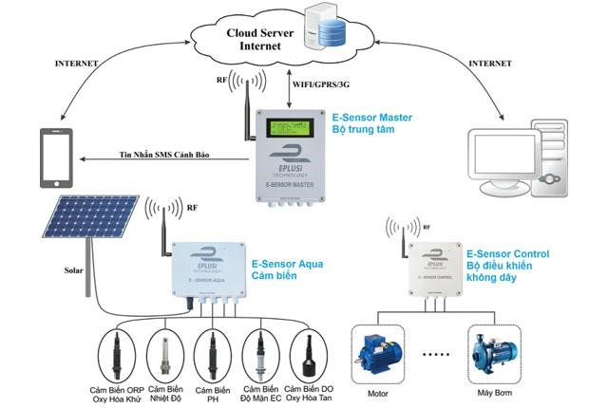
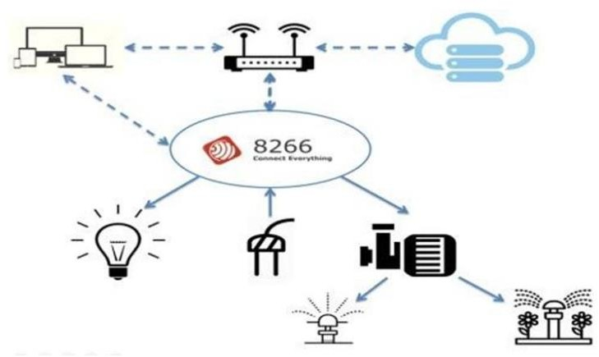

INTRODUCTION
There are numerous IoT applications in aquaculture as…
IoT tech. application for shrimp farming model in Hoa Hiep village, LongAn (2015)
https://mimosatek.com
IoT tech. application for Irrigation and lighting system for crop care (Ha Noi)
Bui Thi Thanh et al, 2019

Slide 4
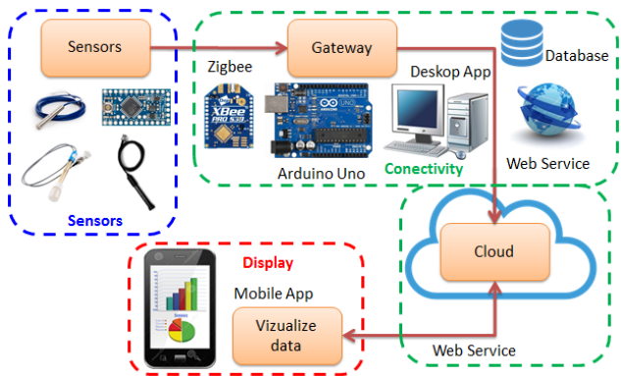
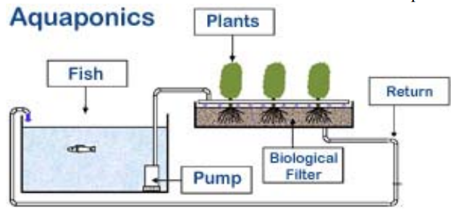
INTRODUCTION
There are numerous IoT applications in aquaculture as…
IoT system for the monitoring of water quality in aquaculture
Cesar et al, 2017
Monitoring of the Environmental parameters of an Aquaponic System Based on IoT
Manju et al, 2017

Slide 5

INTRODUCTION
Water quality is determined by factors like
Dissolved Oxygen,
temperature,
turbidity,
transparency,
water color,
ammonia
carbon dioxide,
alkalinity,
hardness,
conductivity,
salinity,
TDS,
pH,
nitrate,
nitrite,
BOD
Illustration: Catherine Song
© The Spruce, 2019
Dolan, 2015

Slide 6
INTRODUCTION
Water quality is determined by factors like
Dissolved Oxygen,
temperature,
turbidity,
transparency,
water color,
ammonia
carbon dioxide,
alkalinity,
hardness,
Parameters whose imbalances cause the imbalances of others
(Saha et al., 2018)
conductivity,
salinity,
TDS,
pH,
nitrate,
nitrite,
BOD,
(Abhay et al., 2018)
(Cesar et al., 2017)
(Lin & Tseng, 2019)
(Manju et al., 2017)
(Sajal et al., 2018)
(Kori et al., 2019)
(Satya et al., 2012)
(Danh et al., 2020)
(Defa et al., 2019)
Dolan, 2015

Slide 7
INTRODUCTION
Table 2. Recommended water quality parameters
Parameter | Unit | Acceptable | Desirable range
Temperature | ⁰C | 25-35 (Delincé, 1992) | 28-32 (Svobodová et al., 1993)
pH |  | 6.5-9.0 (Saha et al., 2018) | 7.5-8.5 (Santhosh & Singh, 2007)
Dissolved Oxygen | mg/L | >3.0 (Mallya, 2007) | >3.5 (Danh et al., 2020)

Slide 8
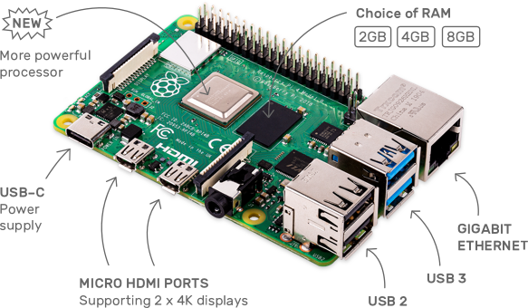
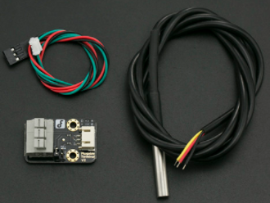
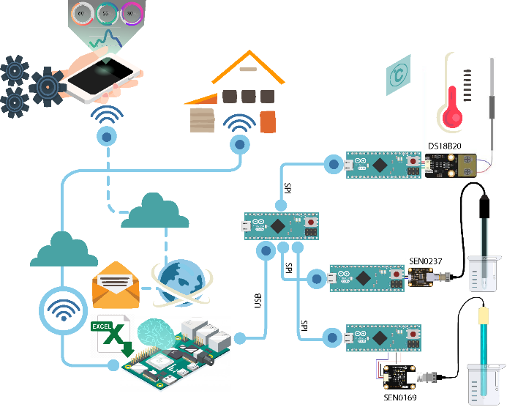
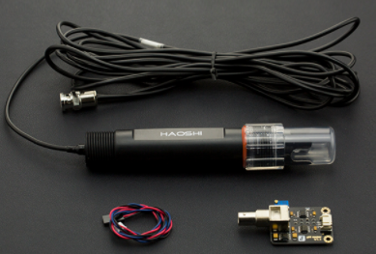
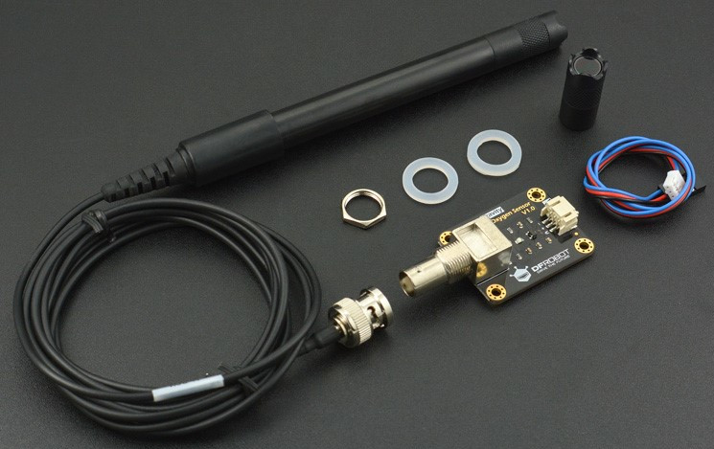
AQUARIUM SENSORS AND HARDWARE
www.raspberrypi.org
www.dfrobot.com

Slide 9
HARDWARE AND SOFTWARE DESIGN
A clock signal (SCLK) sent from the bus master to all slaves (pin 13)
A slave select signal (SSn) for each slave (A1-3: Master, pin 10: Slaves)
A data line from the master to the slaves (MOSI – pin 12, MISO – pin 11)
Master init SPI transfer progress
Master send a byte to select Slave devices
S.selected dev. sends data byte to Master
Master generates info onto the MOSI line
Master and Slave Arduino communication
https://github.com/thinhdoanvu/NTU_Project2021/spi.ino

Slide 10
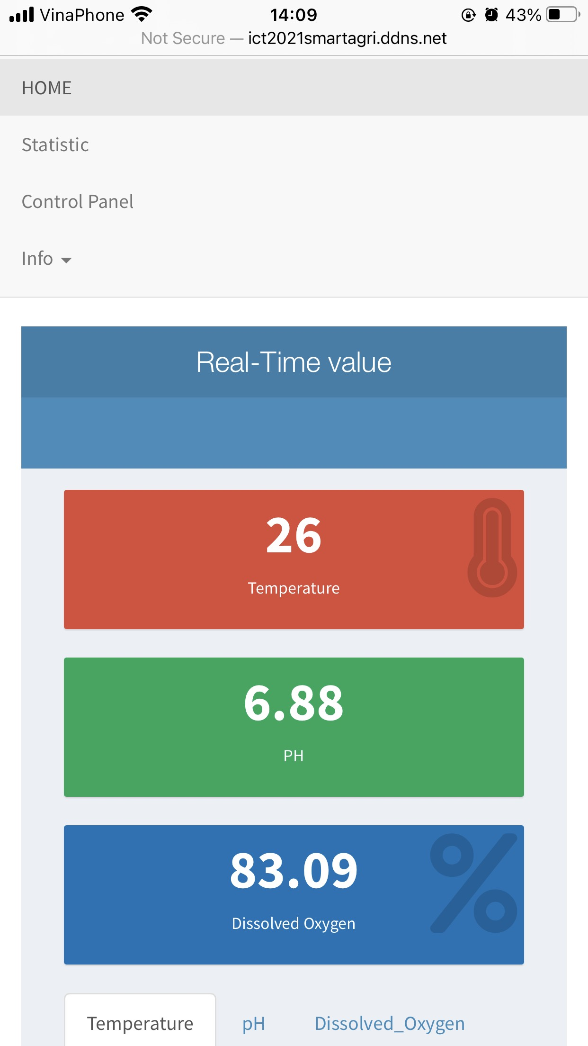
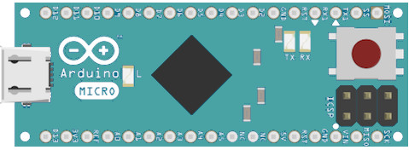
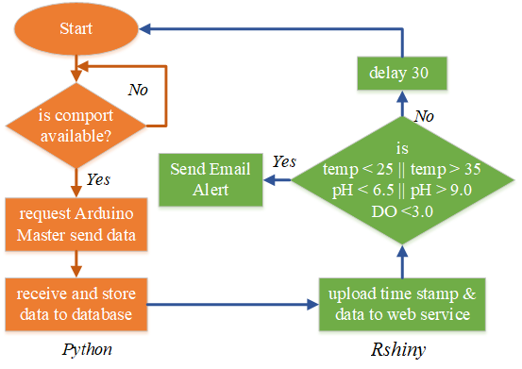
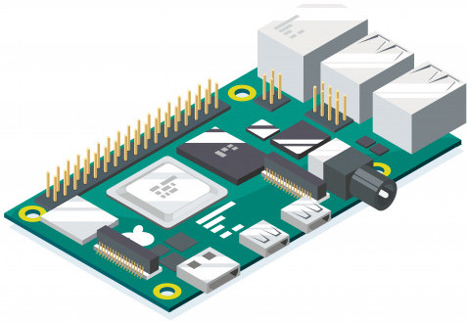
HARDWARE AND SOFTWARE DESIGN
Master and Raspberry pi communication via USB port
https://github.com/thinhdoanvu/NTU_Project2021/blob/main/savedata.py
Display sensed data on smartphone screen
https://github.com/thinhdoanvu/IoT/

Slide 11
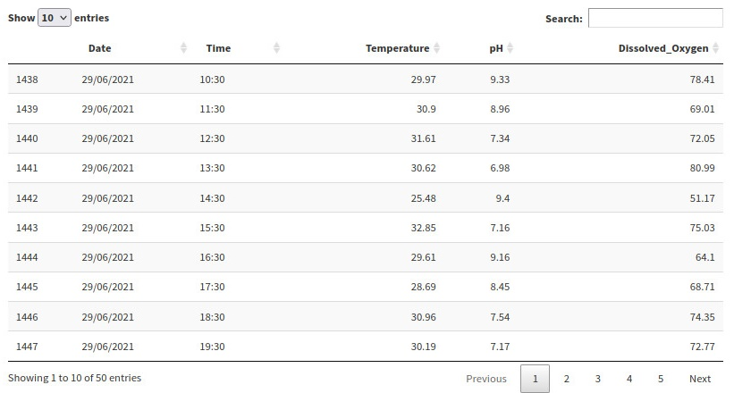
HARDWARE AND SOFTWARE DESIGN
Storing data in to .csv format file

Slide 12
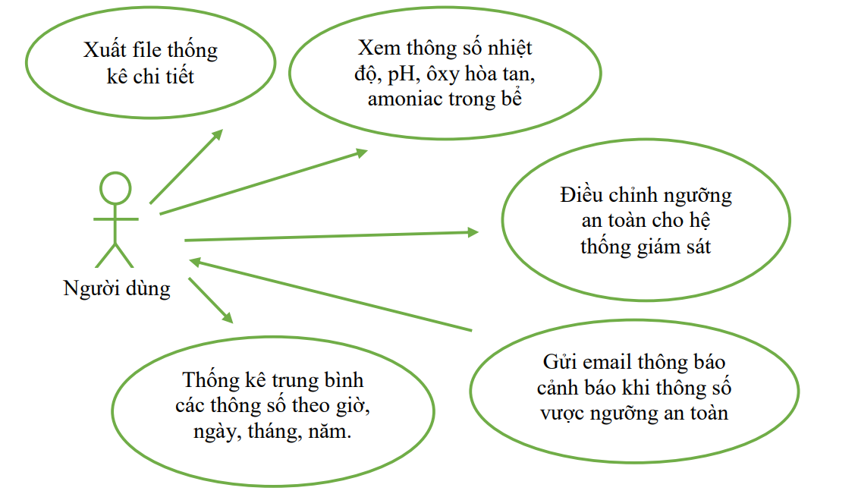
HARDWARE AND SOFTWARE DESIGN
Export data
View sensed data (temp, OD, pH)
Setting threshold values of water
parameters
Users
Email alert messages
Visualization results of sensed data

Slide 13
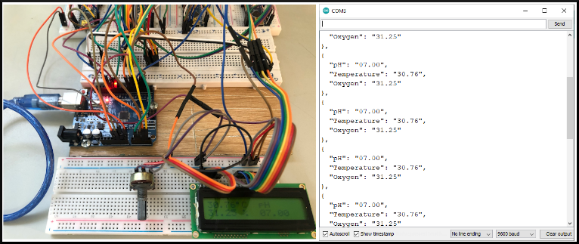
RESULTS
TempSlave
pH
Slave
DO
Slave
RTC
Master
LCD 16x2
Sensors value (left) and transmission data between master device and computer via comport (right)

Slide 14
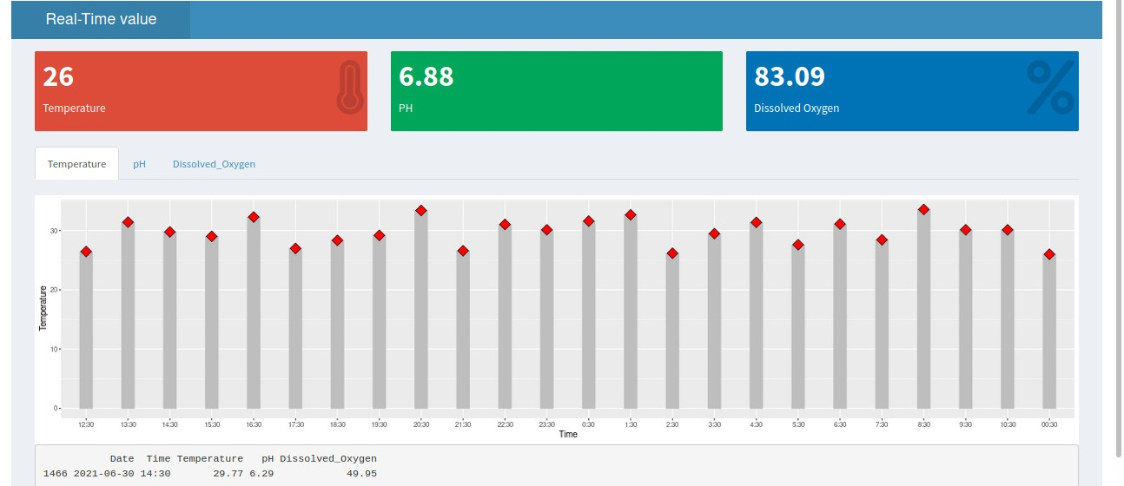
RESULTS
latest value collected from sensors
Sensors
Historical data
detail of values by clicking at a point
The visualization results of sensed data

Slide 15
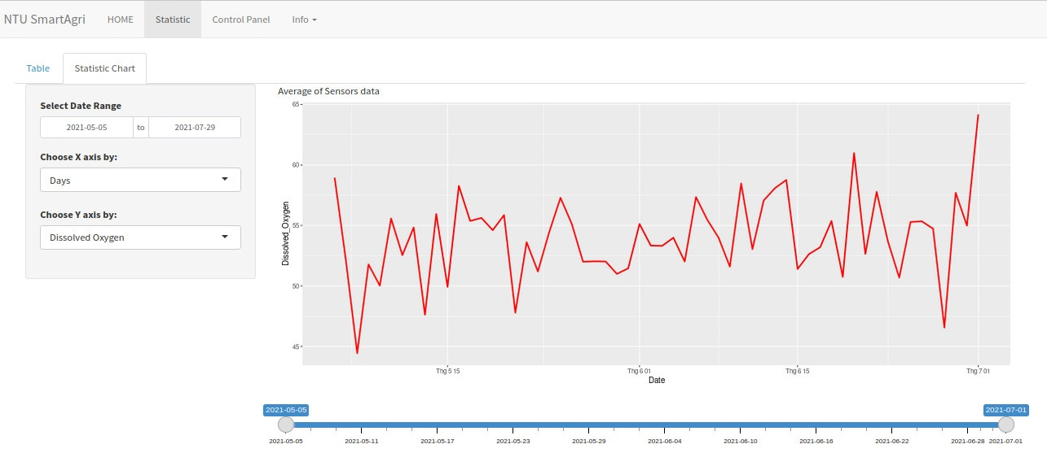
RESULTS
axis value
The time series of the sensed data

Slide 16
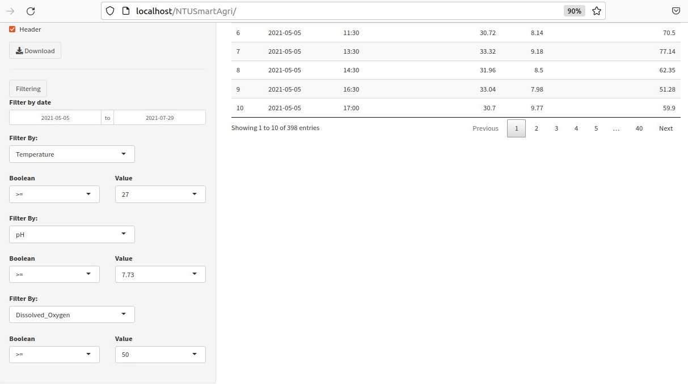
RESULTS
Download data to client
Criteria
Filtering data by setting criteria ranges

Slide 17
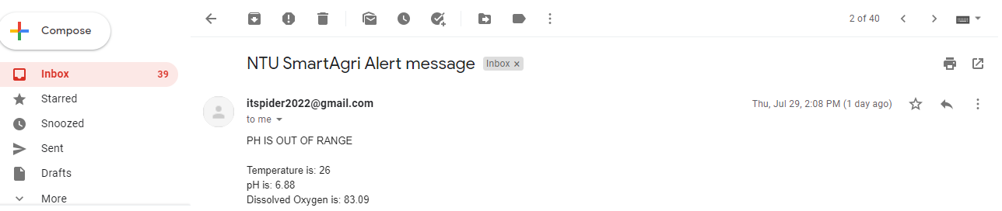
RESULTS
Email alert messages (pH is out of range while others are acceptable)

Slide 18
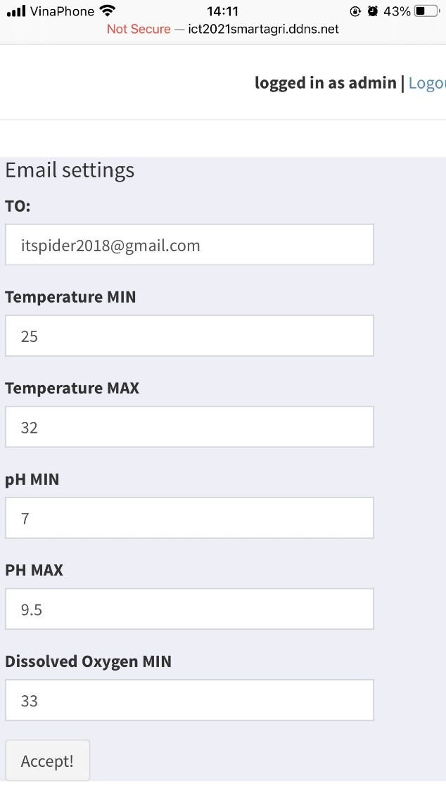
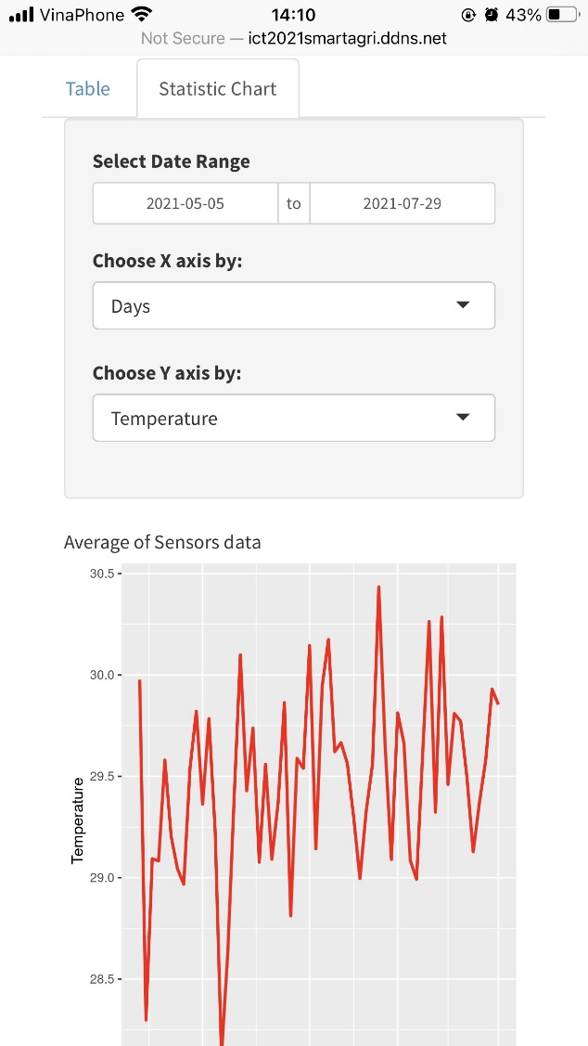
RESULTS
Set data range

Slide 19
CONCLUSIONS
System offers users the ability to monitor in real time the most important water quality parameters (pH, Temperature, Dissolved Oxygen)
Sensors were interfaced to the Arduino microcontroller (SPI)
System parameters were displayed through LCD and website
Provides an e-mail alert when fish tank water parameters reach out of acceptable levels
Data stored in a database can be downloaded to clients
Future work, we will focus on how to control water quality

Slide 20
ACKNOWLEDGMENT
We are extremely thankful to Nha Trang University who helped us with all the facilities, resources for this study

Slide 21
Thank you for watching

